Slide 1
Welcome to
Preschool Orientation!

Slide 2
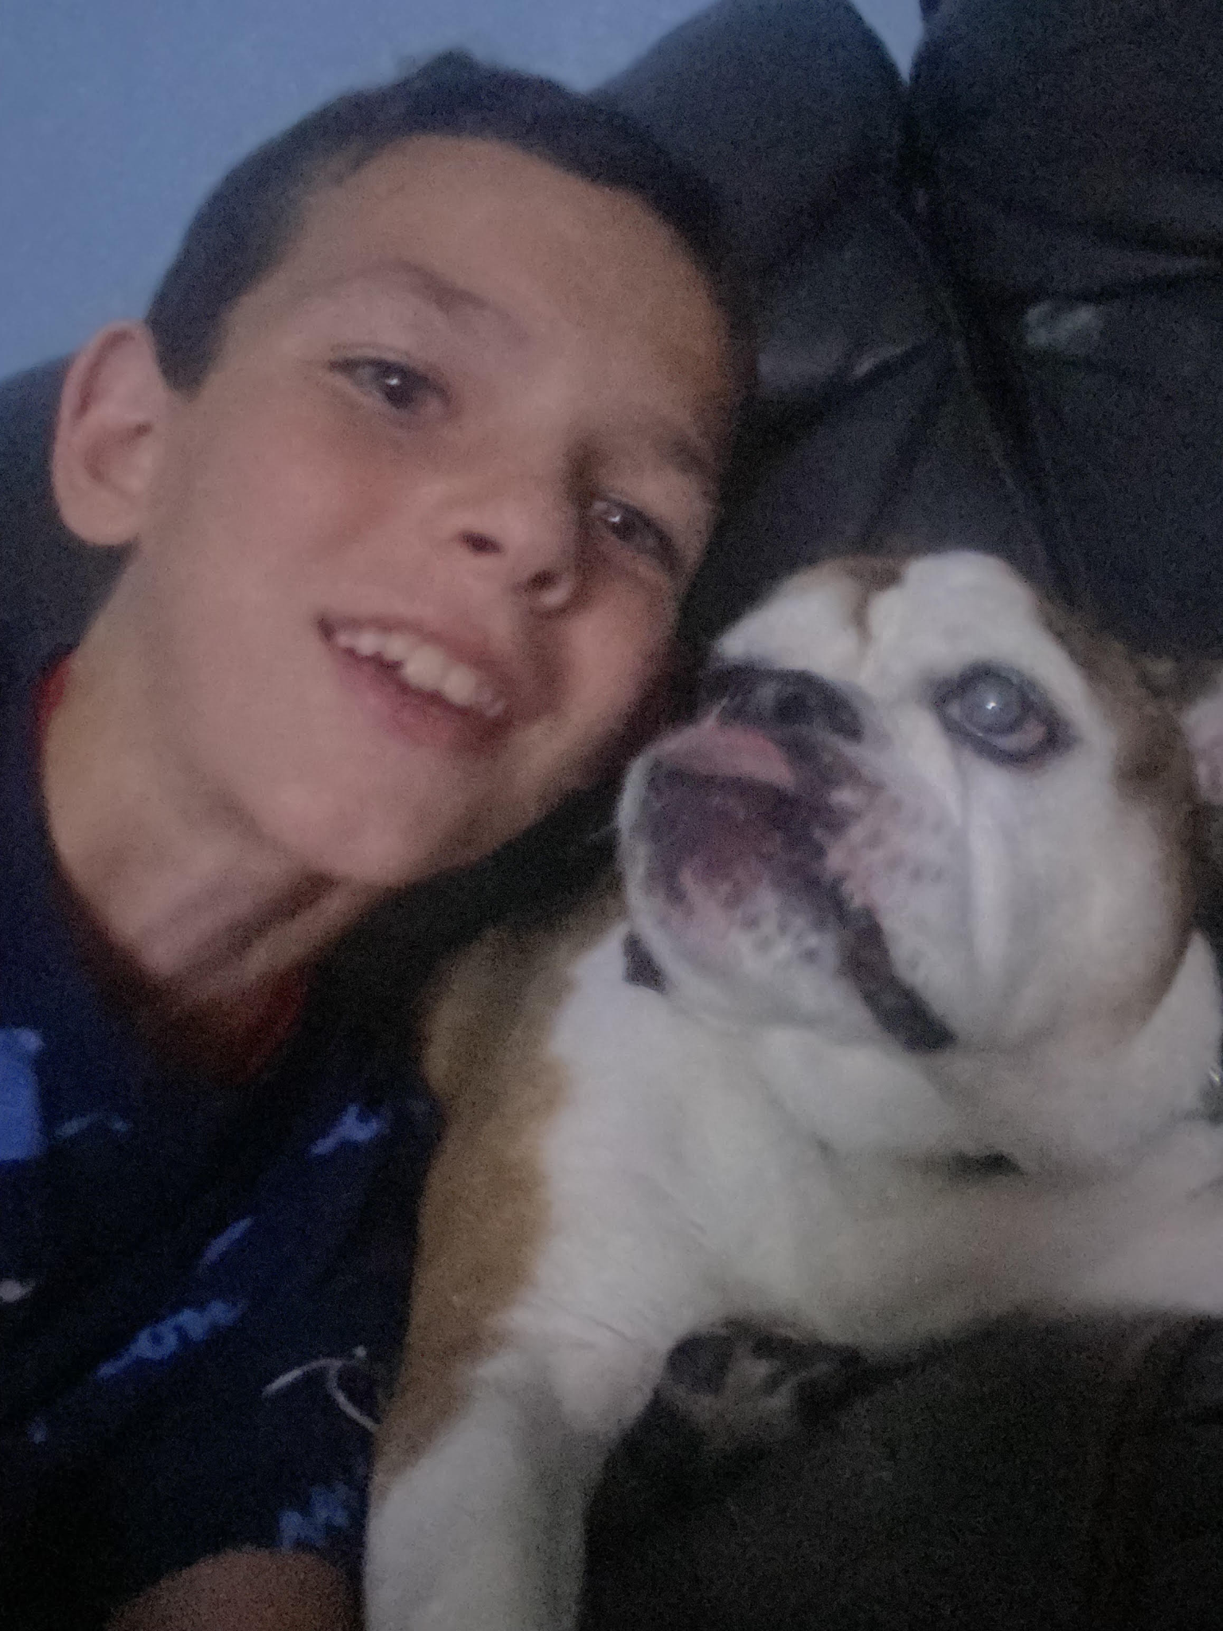
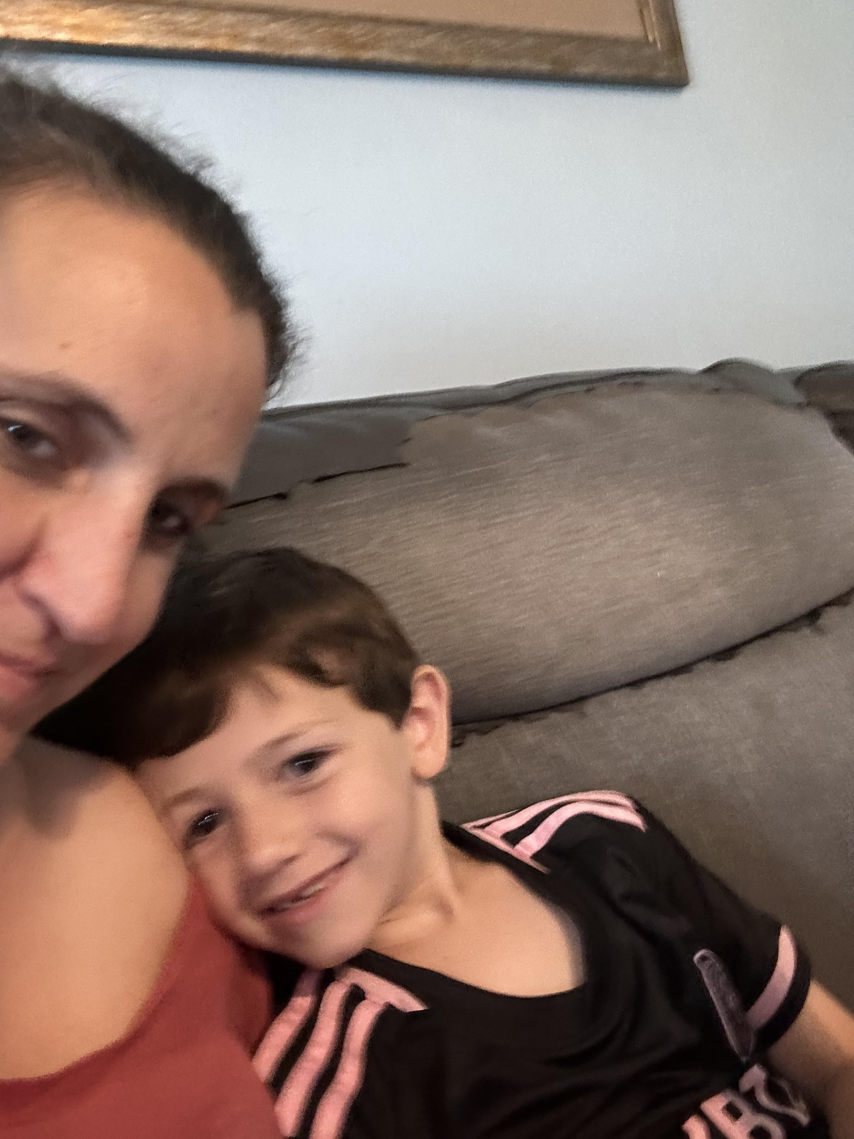
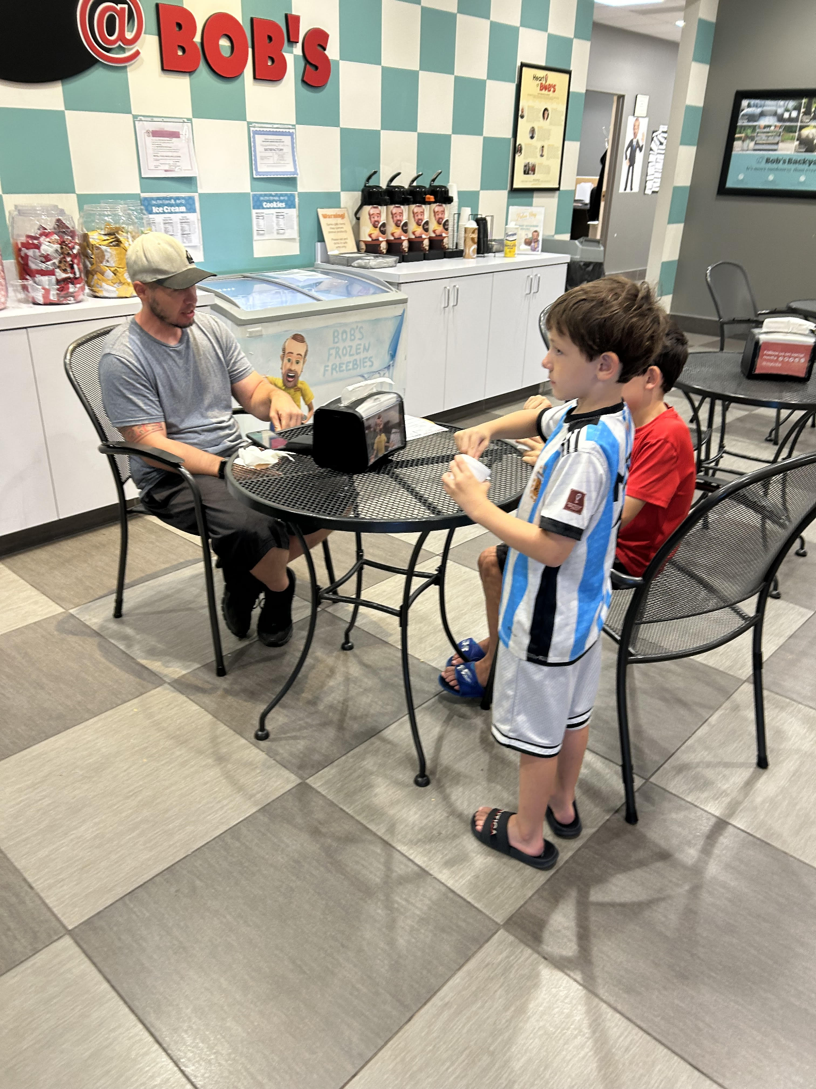
Mrs. Jacky Gallipoli
-Teaching 16 years
-Dylan-10 Cameron-7
-Dog Chaz 14 years old (Husband, Kenny)

Slide 3
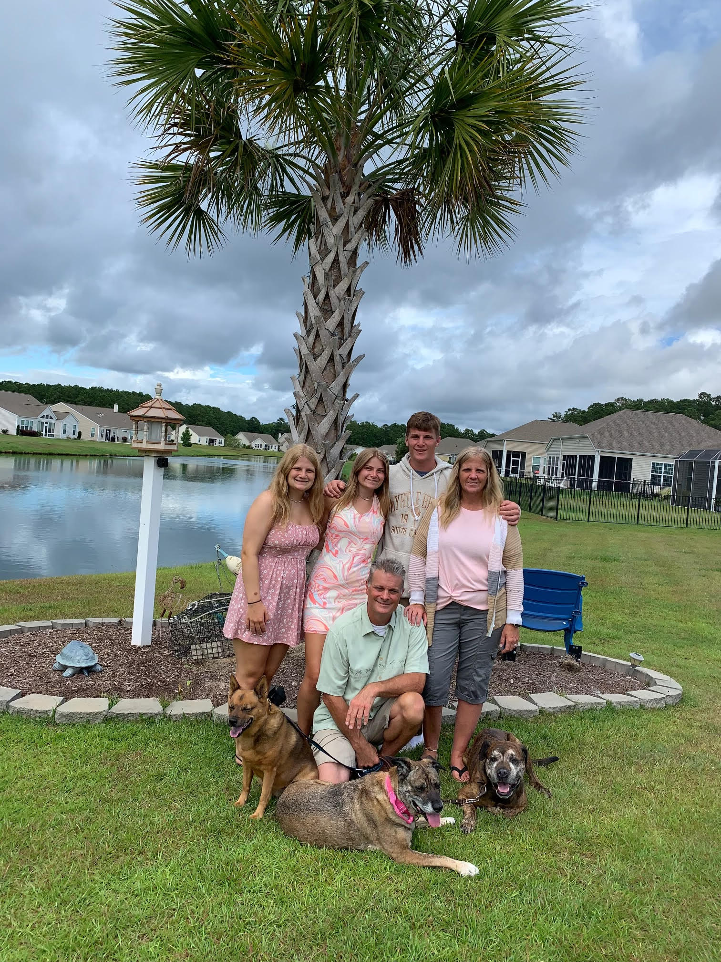
Mrs. L

Slide 4
Outline of Activities
Introductions
Bus Visit or Bus Safety Video
Class Overview
Back To School Information
Teaching Strategies App
Class Pages
Other Important Topics
Questions?

Slide 5
Class Overview
Pick Up & Drop Off at Door 14 unless your child is taking the bus. Please bring your ID for Pick up.
Program Hours: Full Day 9:10am- 3:20pm. Arrival/Drop off starts at: 9:10 . Pick up at 3:10pm. Preschool dismisses a little earlier than the school to ensure a smoother dismissal for our little ones.
About our Preschool Program: We follow the Creative Curriculum Program and their objectives. During the year, we will complete studies on interest areas like Trees, Insects, Musical Instruments, Building, Clothing, Etc. The students will enjoy learning and playing in Centers each day where they will work on different skills and learn about the studies we are working on. We encourage independence and self-help skills throughout the day.
We use the Creative Curriculum: overview of objectives

Slide 6
Back To School
What your child needs for Back To School:
Student IDs- Please send in student ID’s every day. They need it to get onto the bus everyday if they ride the bus. They will need their student ID’s to order school lunches.
Send in a backpack, folder and communication book, lunch, water bottle & a snack every day (we do not have water to provide students, so please send)
Send in a change of clothes in case of accidents or messes
Every Monday send in a small blanket for rest time. They will be sent home every Friday to be washed and returned. Items need to fit in small cubby area.
Please label everything with your child’s name
If your child needs pull ups and wipes, please send those in
Lunch & Snacks- If your child would like to order lunch, please let me know. If not, please send in a lunch and drink. Provide a snack and drink for our afternoon snack time.
Please let me know if your child has an allergies

Slide 7
Teaching Strategies Family
The Teaching Strategies Family App helps you build connections with your child’s teachers through clear and meaningful two-way communication streams (just like Remind).
Stay connected to the learning that is taking place in your child’s classroom with multimedia-playlists, engaging activities, and two-way messaging with your child’s teacher.
Invitations will been sent to your email soon. I will use the first contact in Genesis. If you’d like for me to add another email for another parent/guardian please let me know.
I can send digital books via Teaching Strategies that connect with our class studies.

Slide 8
Class Pages
How to get to the class page-
My class page: https://www.jacksonsd.org/Domain/1130
Johnson’s Homepage: https://www.jacksonsd.org/Page/15
Jackson homepage: https://www.jacksonsd.org/
District Preschool Web Page Preschool News and Information

Slide 9
Other Important Topics
Healthy Lunch Choices: The DOE mandates this as part of our program. See handouts on healthy food choices for lunch and snack
Attendance: Preschool lays the foundation for academic skills and future attendance habits. Preschoolers gain this by attending school regularly. (see handouts for more information)
Genesis Contact Information: Please make sure there are multiple names on the emergency contact form besides parent(s) and/or guardian(s)
(See handouts for more information)

Slide 10
Questions?
If you have any questions or concerns, please contact me via the communication book or email jgallipoli@jacksonsd.org
Thank you for attending the Preschool Orientation!

